Slide 1
Dr. Md Asaduzzaman Khan
Email: asadkhanbmj@yahoo.com
[Brac University, 2023]
Introduction to Biology (BIO 101), Section 2

Slide 2

Biomolecules of Life
Course: BIO 101: Introduction to Biology
Chapter: 3

Slide 3
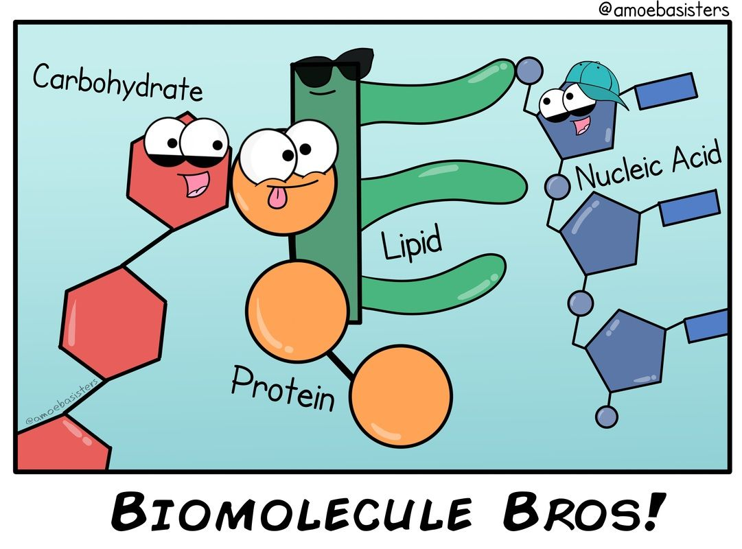
What are Biomolecules?
Biomolecule are molecules and ions present in organisms that are essential to one or more biological processes.
Most biomolecules are organic compounds containing four major elements e.g. carbon, hydrogen, oxygen, and nitrogen.

Slide 4
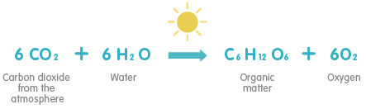
Photosynthesis
Photosynthesis is a process used by plants and other organisms to convert light energy into chemical energy which can later be released to fuel the organism's activities.
Fig- Overall reaction of photosynthesis

Slide 5
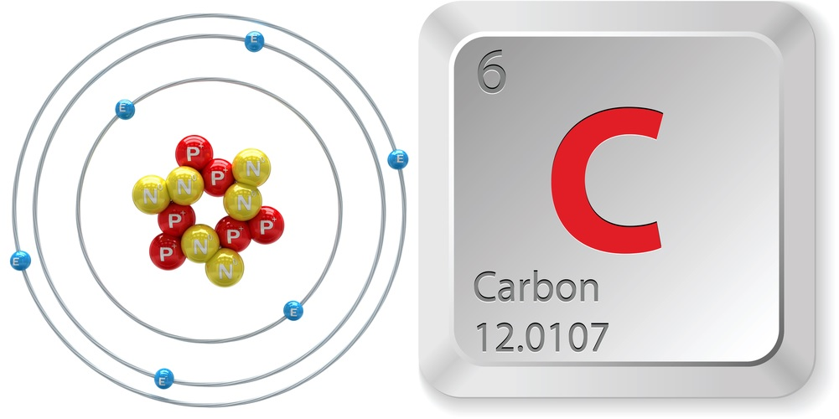
Carbon Bonding Behavior
The carbon atom is unique among elements in its tendency to form extensive networks of covalent bonds not only with other elements but also with itself.
Carbon has four valence electrons, so it can achieve a full outer energy level by forming four covalent bonds.
Carbon can form single, double, or triple covalent bonds with other carbon atoms.

Slide 6
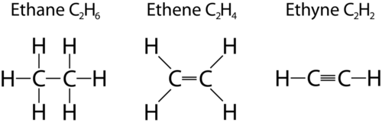
Fig- Carbon bonds on different compounds

Slide 7
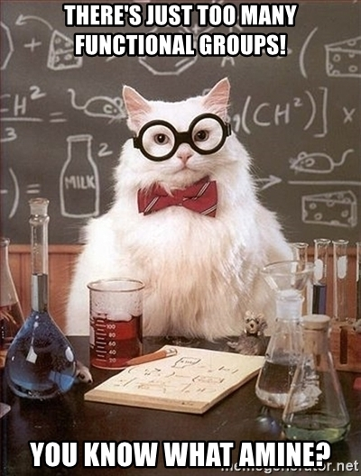
Functional Groups
A functional group is defined as an atom or group of atoms within a molecule that has similar chemical properties whenever it appears in various compounds.
They give organic compounds their different properties.
Example- carboxyl (-COOH) present in carboxylic acids

Slide 8
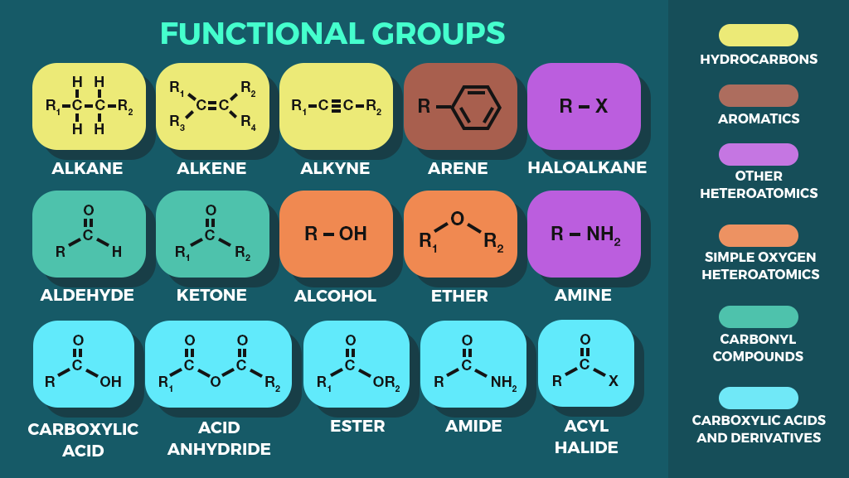

Slide 9
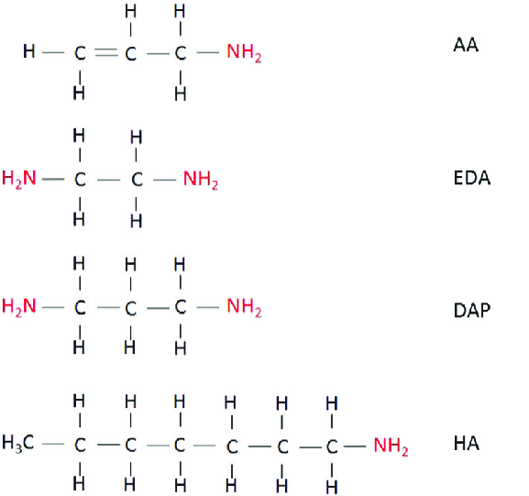
Structure 1- Allylamine
Structure 2- Ethane-1,2-diamine
Structure 3- Propane-1,3-diamine
Structure 4- 1-Heptanamine
Fig- The same functional group in different compounds

Slide 10
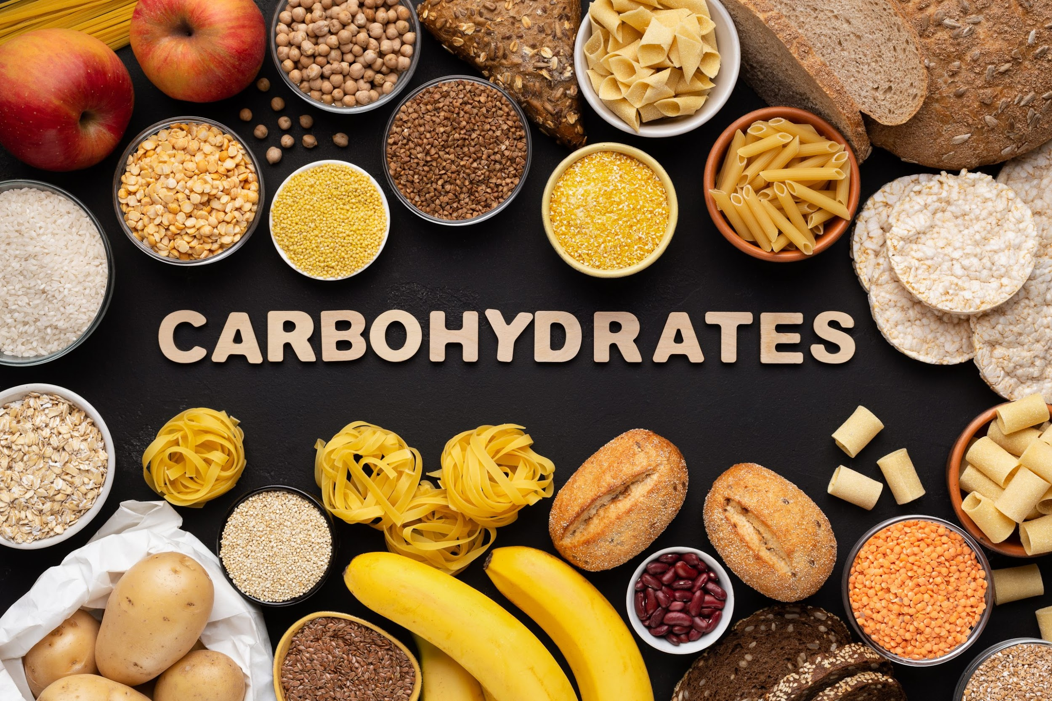
Carbohydrates
A carbohydrate is a biomolecule consisting of carbon (C), hydrogen (H) and oxygen (O) atoms.
Carbohydrates perform numerous roles in living organisms.
They can storage energy(e.g. starch and glycogen), act as structural components (e.g. cellulose in plants) and even form the backbone of the genetic molecule known as RNA.

Slide 11
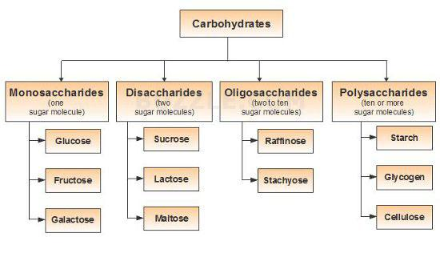
Fig- Classification of carbohydrates

Slide 12
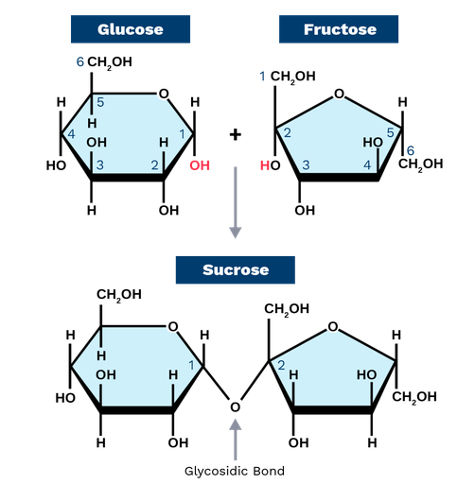
Glycosidic Bond
A glycosidic bond is a covalent bond formed between a carbohydrate molecule and another molecule.
In this reaction, the hydroxyl group (OH) of the carbohydrate combines with the hydrogen of another organic molecule, releasing a molecule of water and forming a covalent bond.
Fig: Sucrose is formed when a monomer of glucose and a monomer of fructose are joined in a dehydration reaction

Slide 13
Lipids
Lipids are molecules that contain hydrocarbons and make up the basic building blocks of biological membranes. They have various function in living cells.
Lipids are not soluble in water as they are non-polar, but are soluble in non-polar solvents such as chloroform.
Examples of lipids include fats, oils, waxes, certain vitamins (such as A, D, E and K), hormones etc.
The functions of lipids include storing energy, signaling, and acting as structural components of cell membranes.

Slide 14
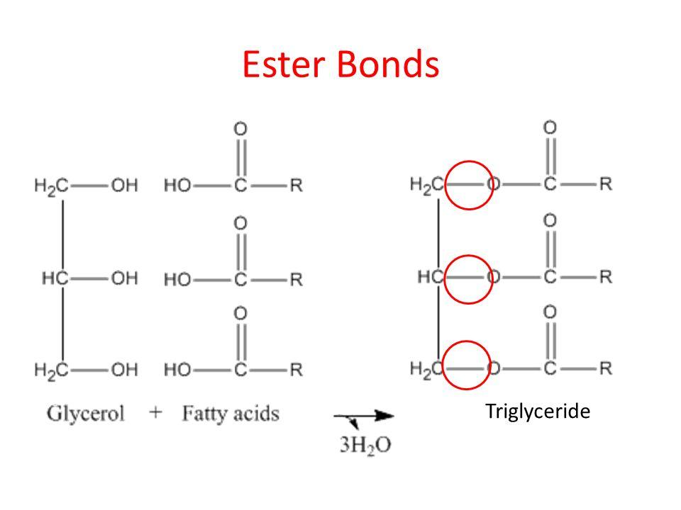
Ester Bond
Glycerol is a small organic molecule with three hydroxyl (OH) groups, while a fatty acid consists of a long hydrocarbon chain attached to a carboxyl group.
The basic unit of lipids are triglycerides . A triglyceride is formed when 1 glycerol molecule links with 3 fatty acid molecules by means of ester bond (covalent bond).
Fig: The glycerol molecule (having three OH− groups) links with three fatty acids via an ester bond

Slide 15
3 Major Types of Lipids
Glycolipids are a class of lipids containing carbohydrate residues. Their role is to maintain the stability of the cell membrane and to facilitate cellular recognition.
A phospholipid is a type of lipid molecule that is the main component of the cell membrane.
Sterols are unique among lipids in that they have a multiple-ring structure. They contain a planar (flat) steroid ring, for example- cholesterol.

Slide 16
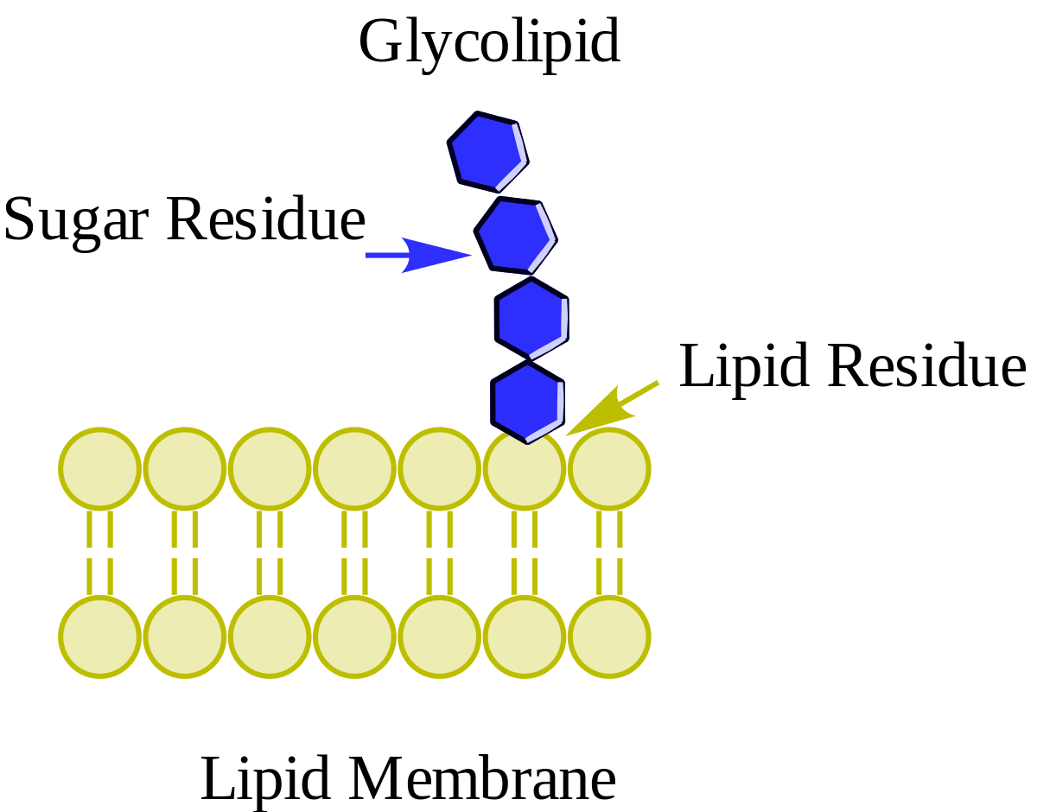
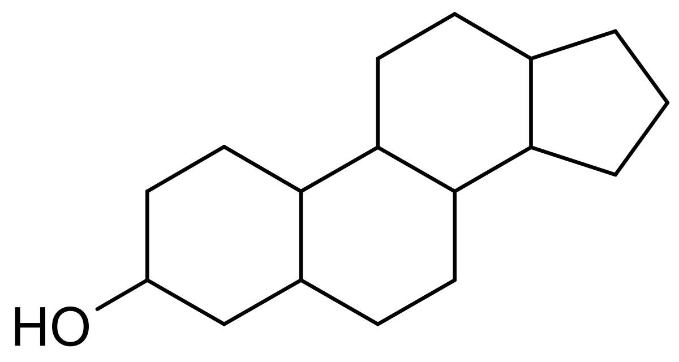
Fig- Glycolipid
Fig- Sterol
Fig- Phospholipid

Slide 17
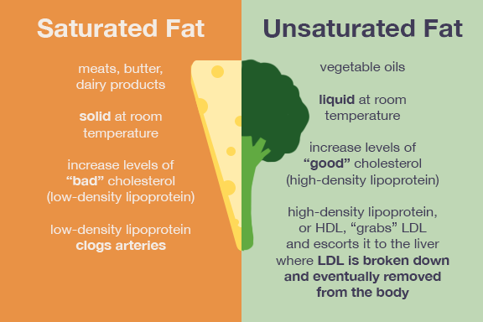
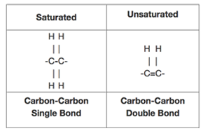
Saturated and Unsaturated Fats

Slide 18
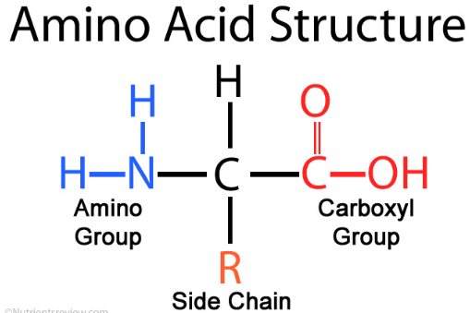
Proteins
Proteins are large biomolecules and macromolecules that comprise one or more long chains of amino acid residues.
Proteins within a cell have many functions, including building cellular structures and serving as enzyme catalysts for cellular chemical reactions that give cells their specific characteristics.
They help in metabolism by providing structural support and by acting as enzymes, carriers and hormones.

Slide 19
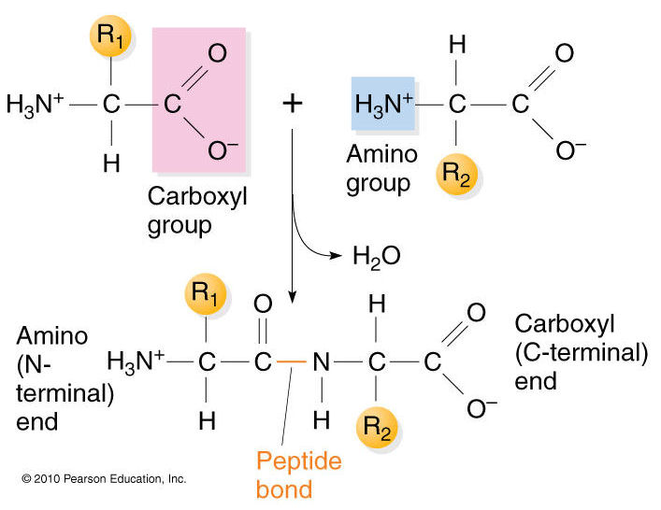
Peptide Bond
Within a protein, multiple amino acids are linked together by peptide bonds, thereby forming a long chain.
A peptide bond is a chemical bond formed between two molecules when the carboxyl group of one molecule reacts with the amino group of the other molecule, releasing a molecule of water (H2O).
Fig- Formation of a peptide bond

Slide 20
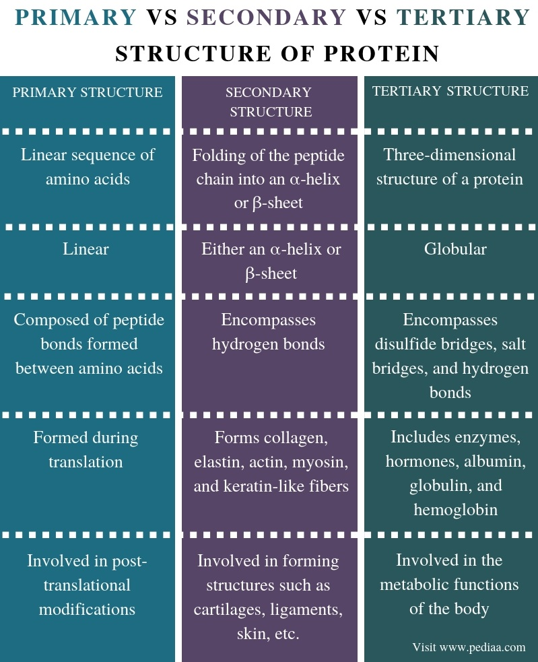

Slide 21
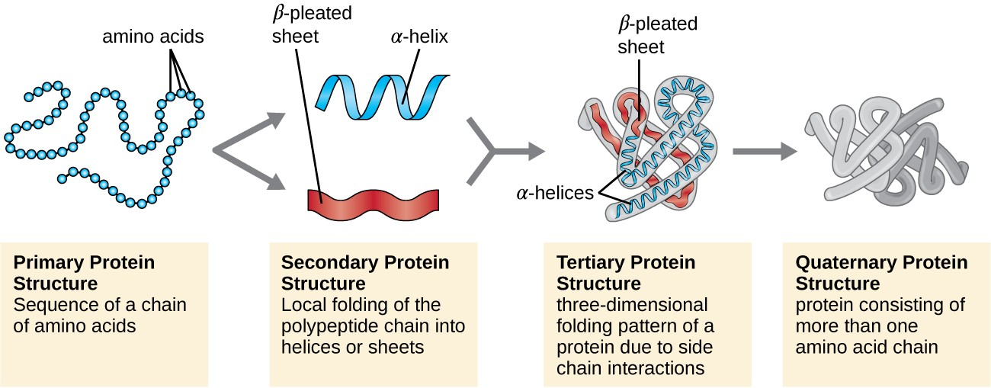
Figure 7: Protein structure has four levels of organization

Slide 22
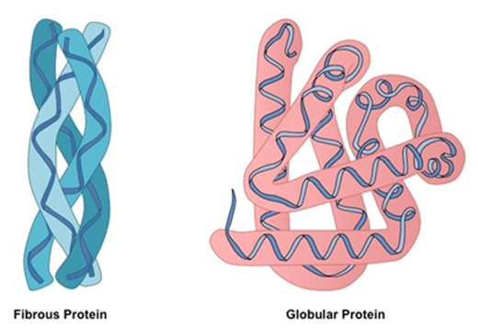
Protein Shapes
Fibrous proteins are typically elongated and insoluble. Examples - collagen, found in the bones, muscles, skin
Globular proteins are generally compact, soluble, and spherical in shape. Examples - Myoglobin, which is found in muscle tissues.
Fig: Fibrous and globular proteins

Slide 23
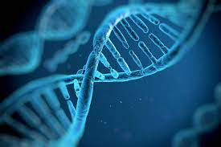
Nucleic Acids
Nucleic acids are essential for all forms of life, and it is found in all cells.
The functions of nucleic acids have to do with the storage and expression of genetic information.
The building blocks of nucleic acids are nucleotides.

Slide 24
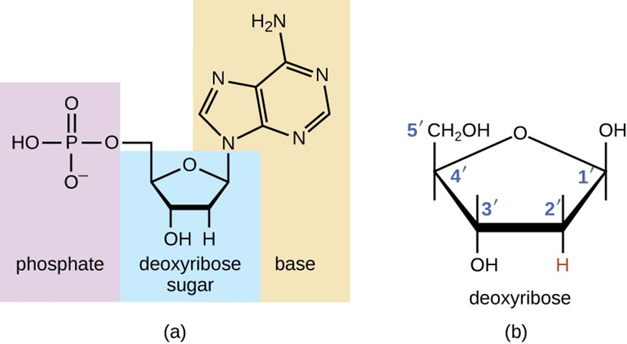
Deoxyribonucleotides
Nucleotides that compose of DNA are called deoxyribonucleotides. The three components of a deoxyribonucleotide are a five-carbon sugar called deoxyribose, a phosphate group and a nitrogenous base.
DNA stores the information needed to build and control the cell.
Fig: (a) deoxyribonucleotide. (b) The five carbons within deoxyribose

Slide 25
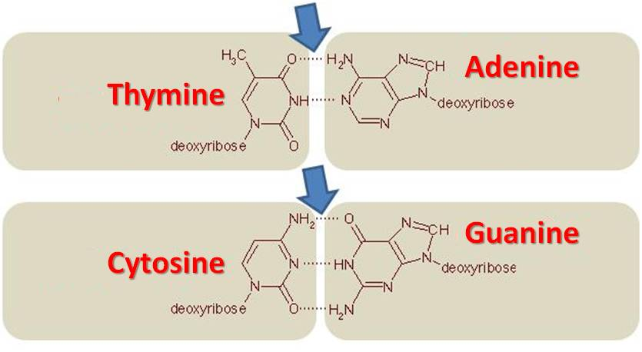
Complementary Base Pairs
In DNA, adenine (A) and thymine (T) are complementary base pairs, and cytosine (C) and guanine (G) are also complementary base pairs.
The base pairs are stabilized by hydrogen bonds; adenine and thymine form two hydrogen bonds between them, whereas cytosine and guanine form three hydrogen bonds between them.

Slide 26
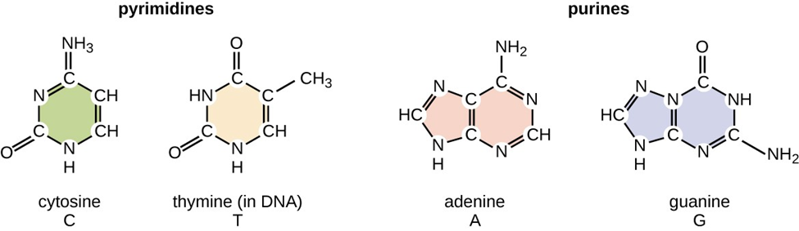
The nitrogenous bases adenine (A) and guanine (G) are the purines; they have a double-ring structure with a six-carbon ring fused to a five-carbon ring. The pyrimidines, cytosine (C) and thymine (T), are smaller nitrogenous bases that have only a six-carbon ring structure. Thymine is unique to DNA
Nitrogenous Bases
Fig- Structure of purines and pyrimidines

Slide 27
Ribonucleotides
Nucleotides that compose of RNA are called ribonucleotides. The three components of a ribonucleotide are a pentose sugar called ribose, a phosphate group and a nitrogenous bases (Adenine, Uracil, Guanine and Cytosine).
The RNA-specific pyrimidine uracil forms a complementary base pair with adenine and is used instead of the thymine used in DNA.
The primary role of RNA is to convert the information stored in DNA into proteins.

Slide 28
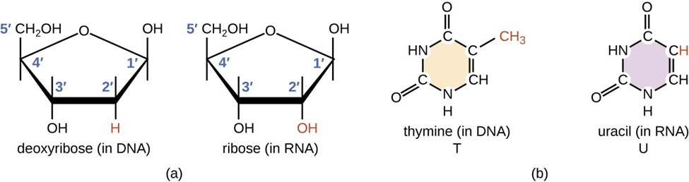
Fig -(a) Ribonucleotides contain the pentose sugar ribose instead of the deoxyribose found in deoxyribonucleotides. (b) RNA contains the pyrimidine uracil in place of thymine found in DNA.

Slide 29
